Slide 1
A Fuzzy Approach to Stock Market Timing
525.770: Intelligent Algorithms Final Project
Sean P. Martin

Slide 2
Overview
Motivation & Problem Setup
Author’s Approach
Author’s Results
My Approach
Results Comparison
Conclusions

Slide 3

Motivation
In A Fuzzy Approach to Stock Market Timing, Dong and Wan demonstrate a Fuzzy System to trade securities
China’s A-Share market companies
Notes:
A-share is the stock shares of mainland China-based companies that trade on the two Chinese stock exchanges, the Shanghai Stock Exchange (SSE) and the Shenzhen Stock Exchange (SZSE).
The motivation is simple, to outperform a buy/hold investment approach by listening to buy/sell/hold recommendations generated by a Fuzzy Inference System

Slide 4
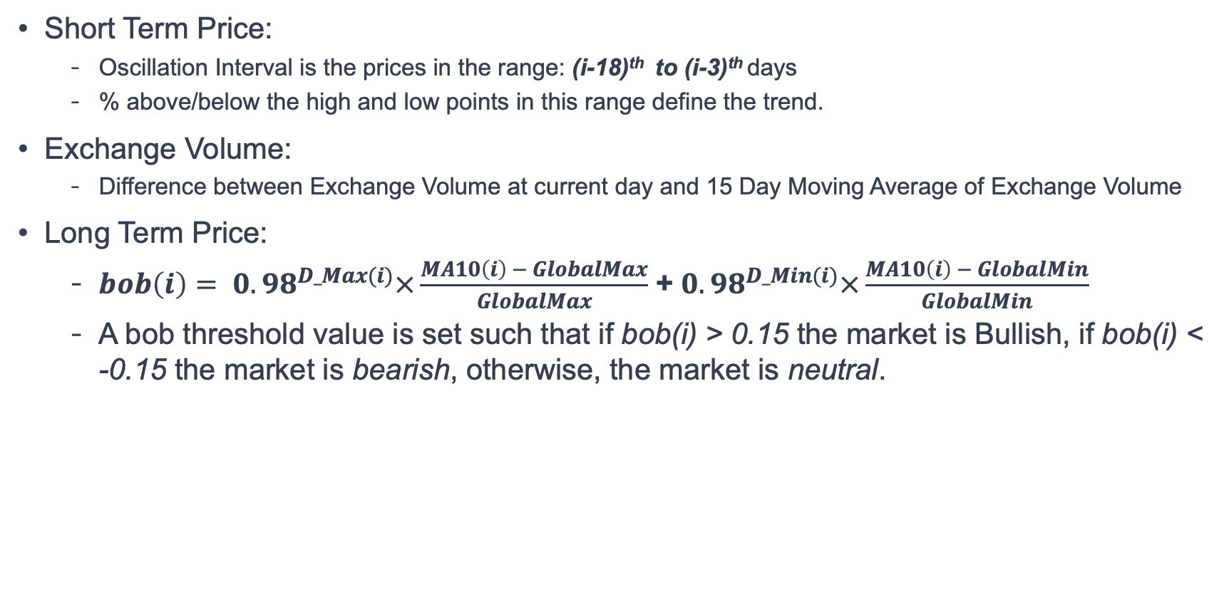
Author’s Approach
Short Term Price:
Oscillation Interval is the prices in the range: (i-18)^{th} to (i-3)^{th} days
% above/below the high and low points in this range define the trend.
Exchange Volume:
Difference between Exchange Volume at current day and 15 Day Moving Average of Exchange Volume
Long Term Price:
$bob\left(i\right)= {0.98}^{D_Max(i)}×\frac{MA10\left(i\right) − GlobalMax}{GlobalMax}$ + ${0.98}^{D_Min(i)}×\frac{MA10\left(i\right) − GlobalMin}{GlobalMin}$
A bob threshold value is set such that if bob(i) > 0.15 the market is Bullish, if bob(i) < -0.15 the market is bearish, otherwise, the market is neutral.
Notes:
The author proposes trending the Short Term Price, Exchange Volume, and Long Term Price of a stock.
Long term history price data is used to determine whether the market is bullish, bearish or neutral.
- D_max and D_min are days from local max/min (200 day window)
- 10 day moving average (MA10) of stock price is used here.
These are used as inputs to the fuzzy inference engine

Slide 5
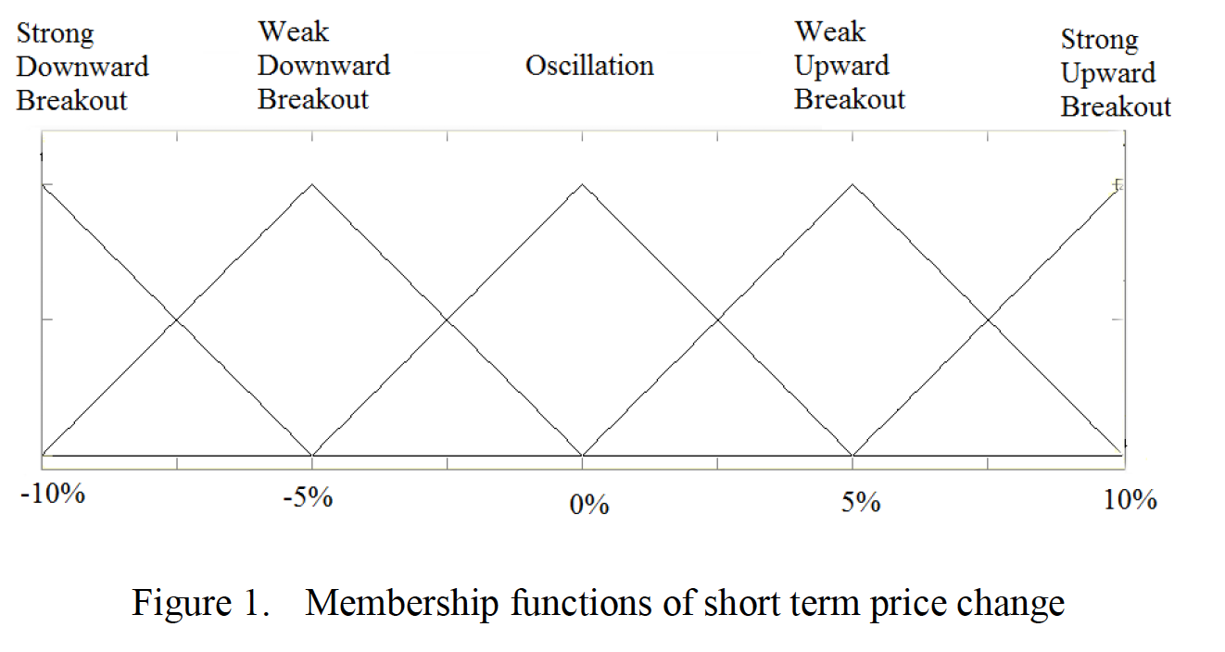
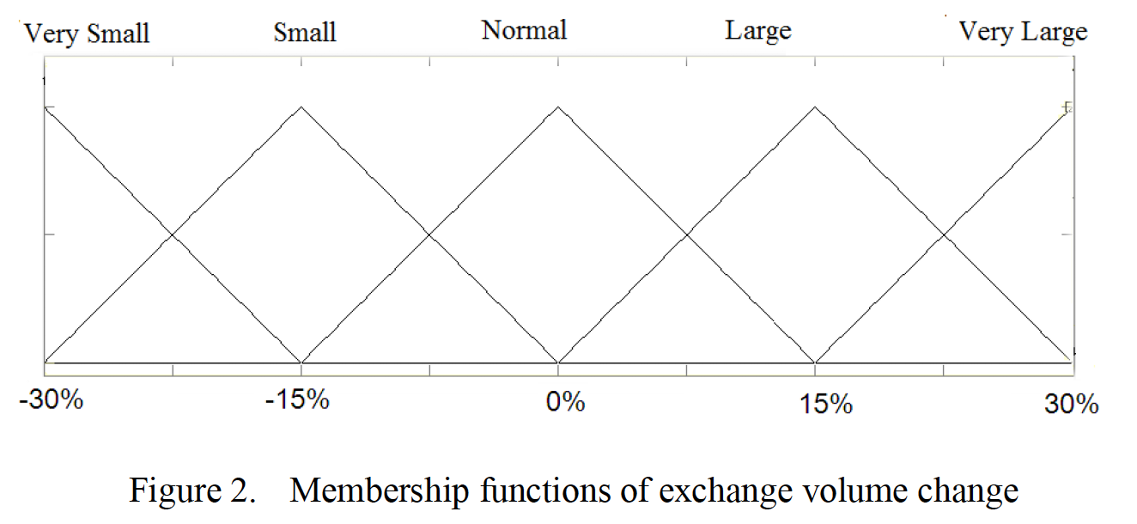
Author’s Approach (Cont.)
The Fuzzy Inference System uses the below Input Membership Functions
All MFs are triangular (including the Long Term Price MF and Output MF)
Output MF Linguistic Variables
Strong Sell (-2), Sell (-1), Hold (0), Buy (1), Strong Buy (2)
Sum Min Inference and CoG Defuzzification are used
Notes:
No plots provided for Long Term Price or Output Membership Functions

Slide 6
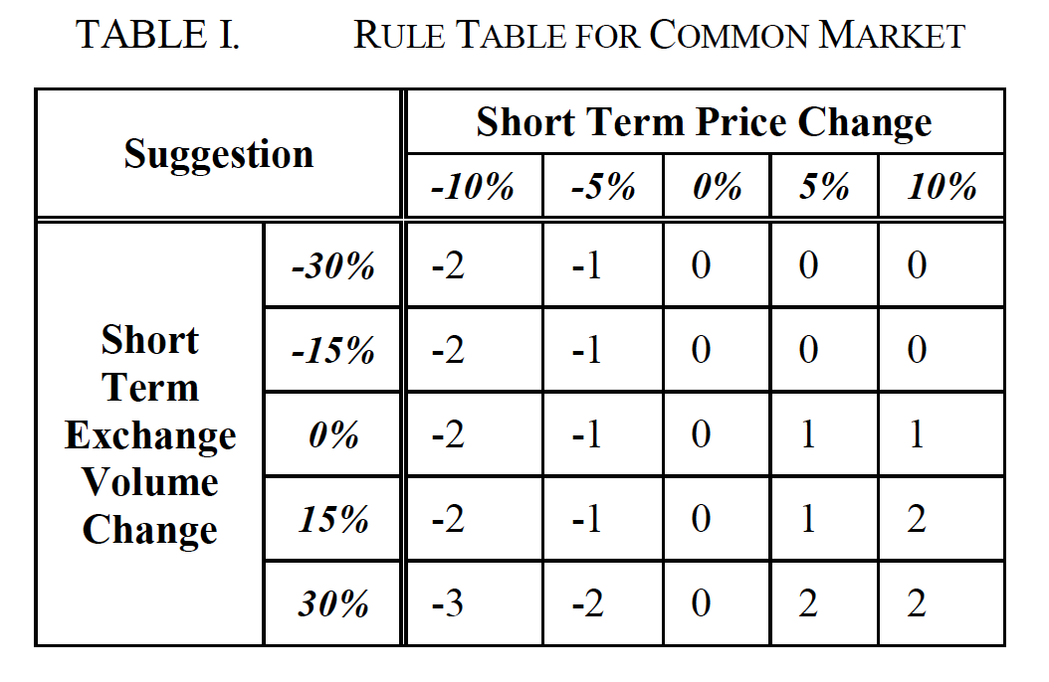
Author’s Approach (Cont.)
The Rule Base used is below.
Strong Sell (-2), Sell (-1), Hold (0), Buy (1), Strong Buy (2)
IF the market is bullish THEN strong buy (2)
IF the market is bearish THEN strong sell (-2)
Sum Min Inference and CoG Defuzzification
Notes:
In total, there are 3 inputs and 1 output. Each of these have five linguistic values they can take on.
Determine ON rules, determine ON rule weights, determine weighted rule conclusions using sum min inference then apply Center of Gravity defuzzification.

Slide 7
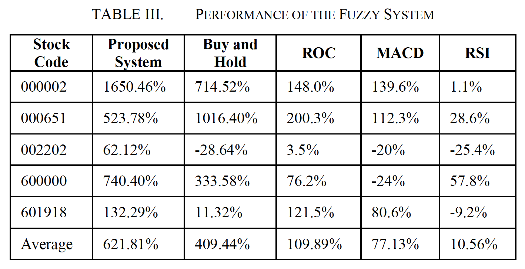
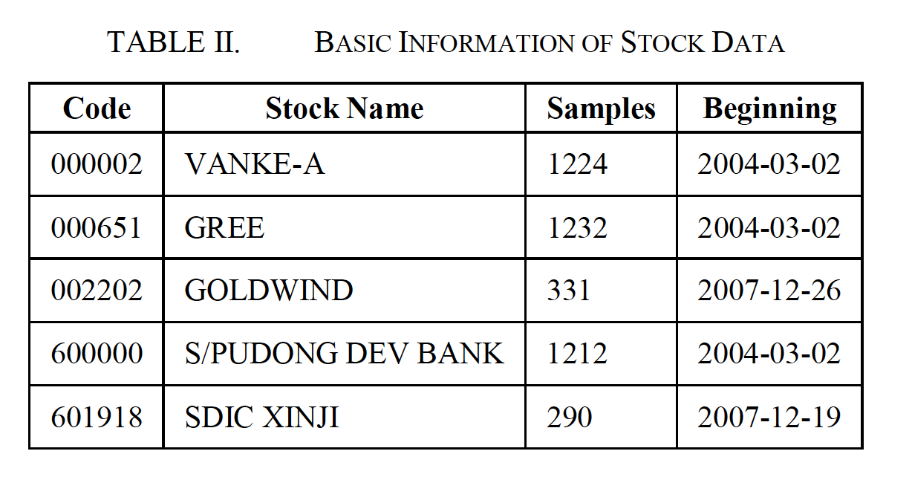
Author’s Results
The Fuzzy System Outperforms the Buy and Hold Investor in 4/5 scenarios.
*End Date: 2009-05-15
Notes:
The start date varied but all stocks had the same end date of May 15th 2009.
They also perform favorably compared to other trading strategies, ROC (Rate of Change) MACD (Moving Average Convergence Divergence), RSI (Relative Strength Index)

Slide 8
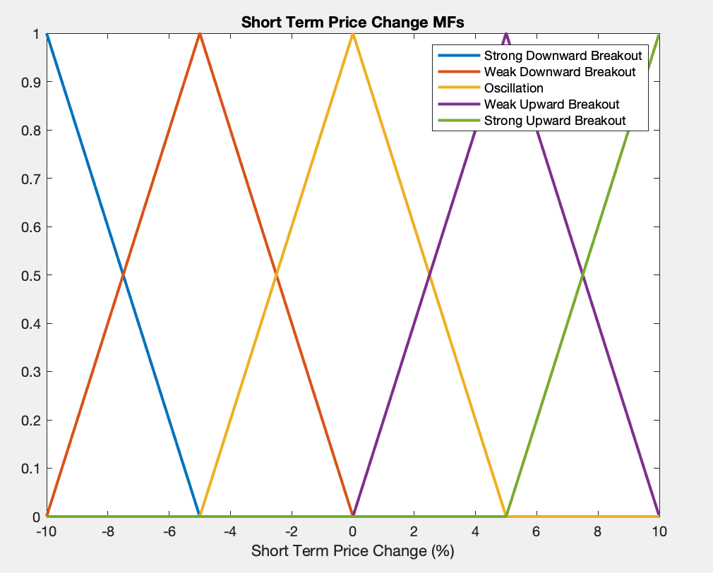
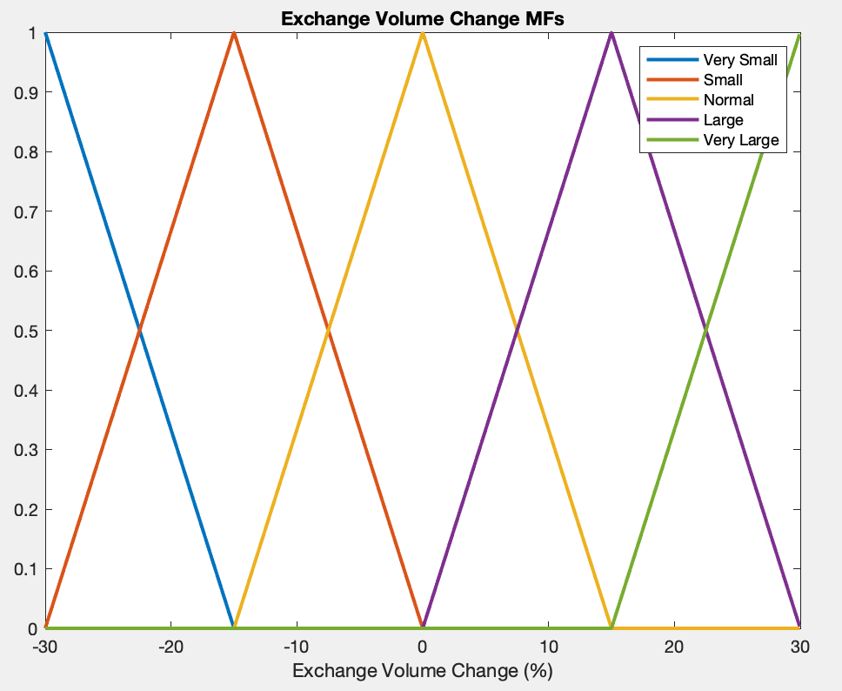
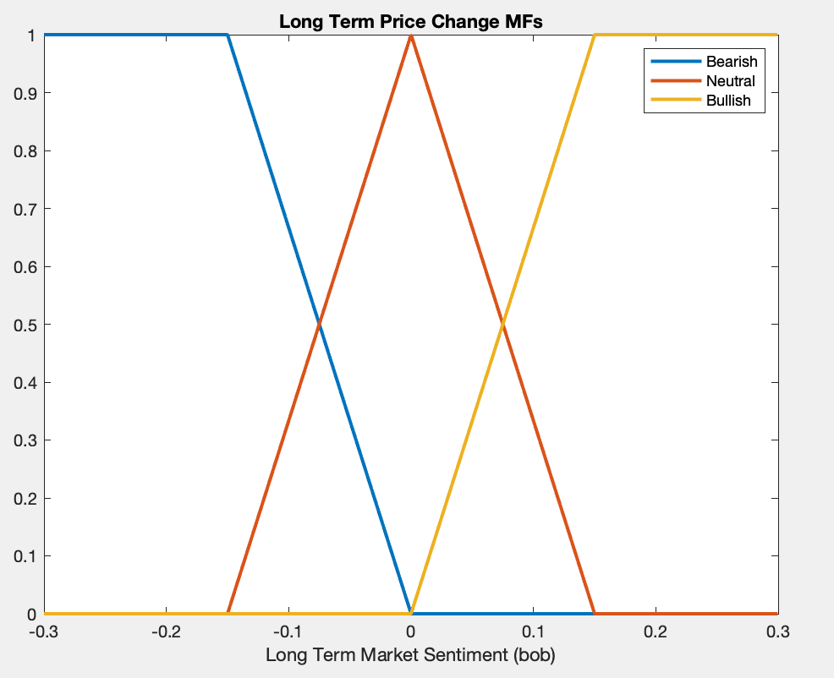
My Approach
Three MATLAB functions written and available on GitHub
create_stock_trends.m
fuzzy_stock_engine.m
fuzzy_stock_trader_main.m
If the fuzzy system gives a strong buy/sell then buy/sell all shares. Otherwise buy/sell 500
Starting capital: $10,000

Slide 9
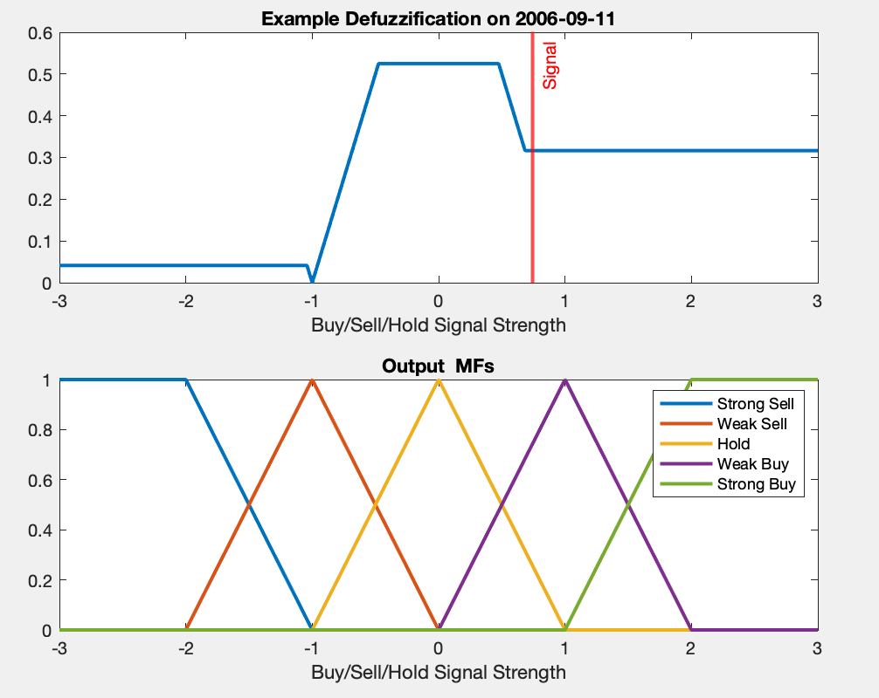
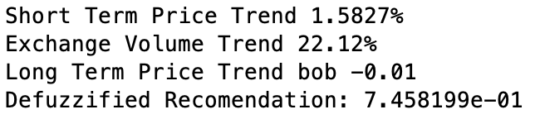
My Results
Depending on Fuzzy System Output either buy/sell all shares or a chunk of shares
My Fuzzy System was able to outperform a buy/hold investor in 4/5 scenarios
However, they are not the same 4/5 scenarios as the author.
Fuzzy Operation on example day below:

Slide 10
Results Comparison
The author provides little details on how to act on the Fuzzy System’s output Buy/Sell/Hold signal.
It is unlikely this is due to improper operation of the Fuzzy Engine
Likely Causes
Yen vs Dollar
Limited detail on how the financial simulation was implemented in the paper. That is, how to act on the fuzzy system’s recommendations
Stock | Author | Buy/Hold | Fuzzy System
VANKE (000002) | 1650.46% | 681.38% | 751.52%
GREE (000651) | 523.78% | 850.86% | 449.81%
PUDONG (600000) | 62.12% | 389.07% | 429.81%
XINJI (601918) | 740.40% | 104.84% | 144.66%
GOLDWIND (002202) | 132.29% | 65.27% | 91.30%
Notes:
Hard to guarantee that how I responded to the fuzzy system output was the same as the authors

Slide 11
Conclusions
A Fuzzy Inference System was developed that can outperform the Buy & Hold investor for certain stocks
Sum Min Inference with Triangular Membership Functions
Author’s Results were difficult to replicate
Overall returns and fuzzy system returns do not match
Notes:
A-share is the stock shares of mainland China-based companies that trade on the two Chinese stock exchanges, the Shanghai Stock Exchange (SSE) and the Shenzhen Stock Exchange (SZSE).
The motivation is simple, to outperform a buy/hold investment approach by listening to buy/sell/hold recommendations generated by a Fuzzy Inference System

